Slide 1
SAT-ACT Analysis
Prepared by : Arti Jariwala
Date: 22nd February 2021

Slide 2
Content Page
Problem Statement
Given Data
Understanding participation rates for SAT & ACT
Comparing SAT & ACT scores
Top 10 States – SAT Participation % Increase
Conclusion
Possible reasons for increase in participation rate
Recommendations

Slide 3
Problem Statement
ACT and SAT are nationally recognized standardized tests and common admission requirements for US schools.
All US colleges/universities accept scores from either the ACT or SAT. These give the students the option which one they would like to undertake.
After the new format for SAT released in 2016, SAT administers are concerned about whether it has impacted the participation rates for SAT.
Hence this project is to analyze the SAT and ACT examination data, conducted in year 2017 and 2018.
Once we have better understanding, we can conclude and provide recommendations to increase the participation rates for SAT.

Slide 4
Given Data
Analysis had been carried out using the following given data fields for individual states:
SAT 2017 & 2018 | ACT 2017 & 2018
Participation Rate | Participation Rate
Math Score | Math Score
Evidence Based Reading & Writing Score | Reading Score
Total Score | English Score
 | Science Score
 | Composite Score

Slide 5
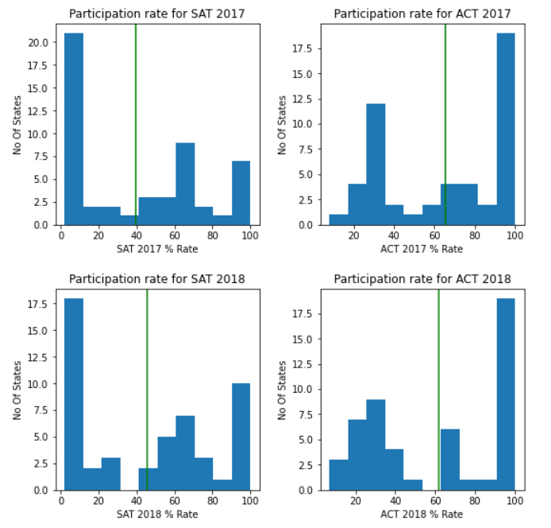
Understanding Participation Rates for SAT & ACT
From the graphs we can see that the participation rates for SAT and ACT varies significantly.
For SAT there are more states whose participation rate falls within the lower range of 1-10 %.
While for ACT, there are more states whose participation rate falls under higher range of 90-100 %.
Note: - depicts the Mean

Slide 6
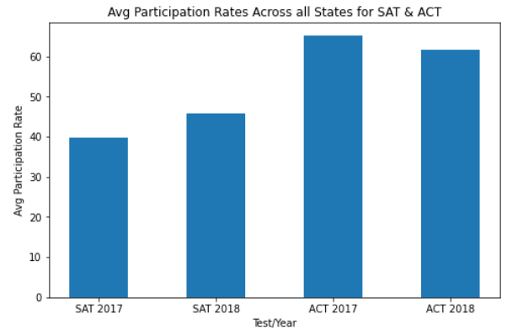
Understanding Participation Rates for SAT & ACT
The average participation rates for SAT 2017 and SAT 2018 is 39.80% and 45.74% respectively.
The average participation rates for ACT 2017 and ACT 2018 is 65.25% and 61.65% respectively.
We have observed an increase by 5.94% in the average participation rates for SAT and decrease of 3.6% in average participation rates for ACT.
However, the average participation rate for ACT is still higher than SAT if we compare across all the states.

Slide 7
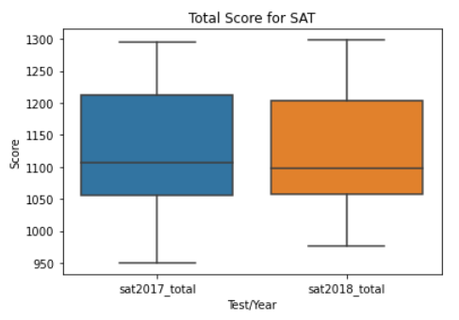
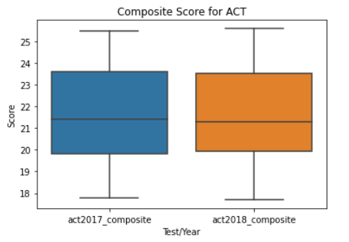
Comparing SAT & ACT Scores
A boxplot graph above gives a good indication of how the values in the data are spread out.
There is not much variation for total scores for SAT for year 2017 and 2018.
The same has been observed for composite scores for ACT 2017 and 2018.

Slide 8
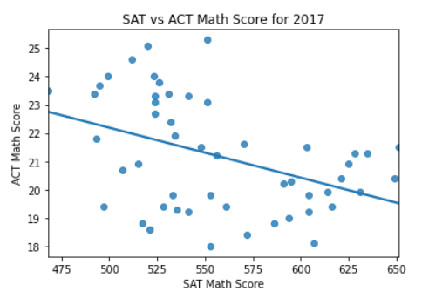
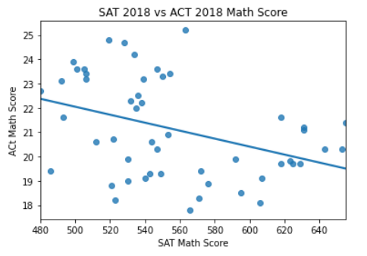
Comparing SAT & ACT Scores
There is a negative relation between SAT and ACT math scores.
No co-relation is observed for both the years.

Slide 9
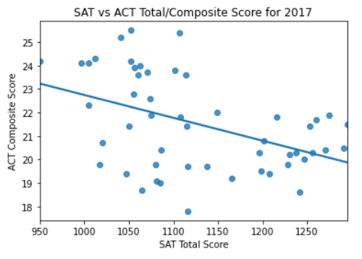
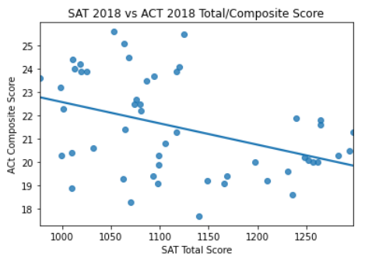
Comparing SAT & ACT Scores
As observed for the Math score, there is a negative relation between the total SAT score and composite SAT score too.
Similarly, no co-relation is observed for the total/composite scores.
The scores do not vary significantly from year 2017 to 2018.

Slide 10
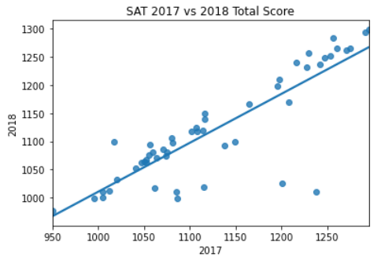
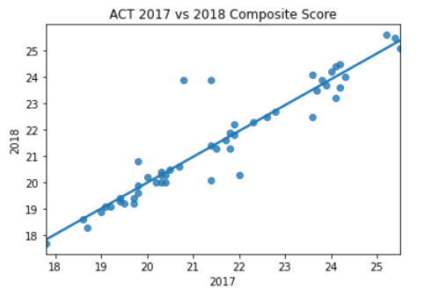
Comparing SAT & ACT Scores
However if we compare SAT 2017 vs 2018 total score we can see that it is more linear.
Similarly the comparison for ACT 2017 and 2018 composite score is more linear in pattern over the two years.

Slide 11
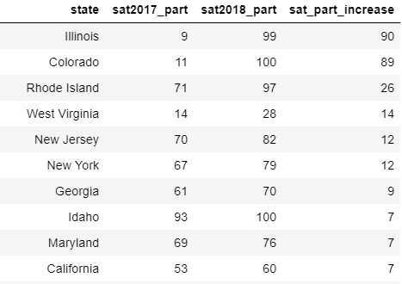
Top 10 States – SAT Participation % Increase
Here is a list of top 10 states whose participation for SAT increased from 2017 to 2018.
We can see a remarkable 90% increase of participation rate for Illinois and 89% for Colorado.

Slide 12
Conclusion
We can conclude that there has been increase in SAT participation rate from 2017 to 2018 by an average of 5.94% but it is still lower in comparison to ACT.
In addition to this, few states like Illinois, Colorado, Rode Island has shown significant increase in the participation rate for SAT in 2018.
Let us consider the possible factors for increase in this participation rate.

Slide 13
Possible Reasons for Increase in SAT Participation
New contracts signed by College Board with Colorado and Illinois has marked tremendous SAT participation growth.
https://www.washingtonpost.com/education/2018/10/23/sat-reclaims-title-most-widely-used-college-admission-test/
In 2017-18, 10 states—Colorado, Connecticut, Delaware, Idaho, Illinois, Maine, Michigan, New Hampshire, Rhode Island, West Virginia—and the District of Columbia gave the SAT to public school students for free.
SAT is allowing the students to take the test on a school day. Jane Dapkus, vice president of the College Board, mentioned that they have seen remarkable expansion in participation rate for SAT due to this reason and they expect to grow even more in coming years.
https://newsroom.collegeboard.org/more-2-million-students-class-2018-took-sat-highest-ever
The new format for SAT has also removed the guessing penalty.
https://blog.prepscholar.com/new-sat-vs-old-sat-quick-summary

Slide 14
Recommendations
It was noticed that participation increased if the students were given fee waiver. Appropriate planning towards minimal fee or fee waiver can improve the participation rate.
North Dakota has the lowest participation rate for both the year 2017 and 2018. But we observed for Illinois and Colorado that the rates increased after they signed the new contract with the College Board. Hence, more states like North Dakota can be engaged in similar contracts to boost the students’ participation rate for SAT.
Another proposal would be to make the mathematics portion less text heavy which may encourage a higher take-up rate of students for SAT.
https://mobile.reuters.com/article/amp/idUSKCN11R1V8

Slide 15
Thank You!

